Slide 1
Data Crunchers
Used Car Explaratory Data Analysis
MEF University Big Data Analytics

Slide 2




Gülce Malkarali Gecenin 4’ü oldu ama yine de bir şey söyleyeceğim….
Selimcan Yilmaz Ama bu data bozuk….
Serkan Ceran Bu saatte bunu farketmemiz iyi oldu…
Timucin Anuslu Dur dur şuna da bakmamız lazım….
Data Crunchers Team

Slide 3
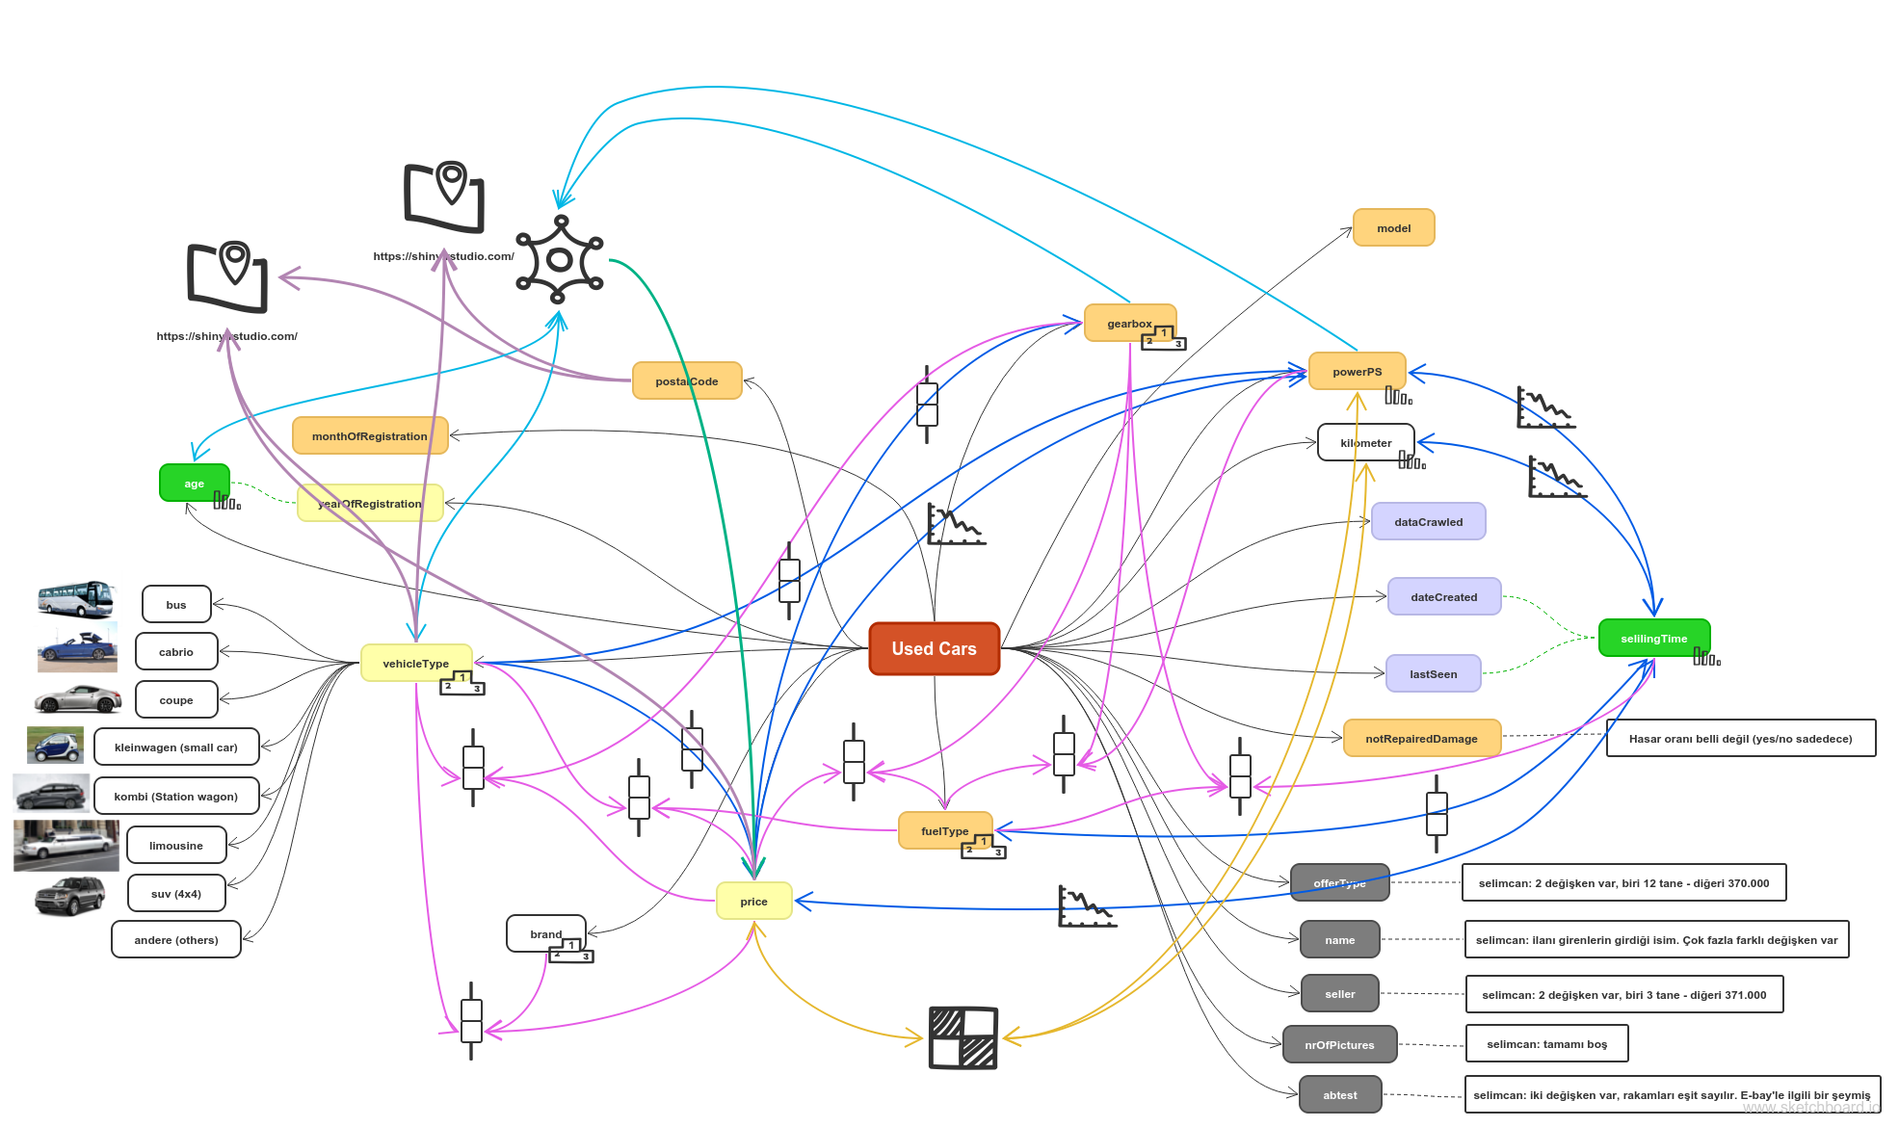
Overall View of Data

Slide 4
Overall View of Data
Used Car Database’ scraped from
Ebay Kleinanzeigen (in German)
370.000 second-hand cars
40 unique brands.
20 variables
Month of Registration
Year of Registration
Kilometer
Postal Code
x
Power PS
Price
Seller
x
Vehicle Type
Last Seen
Offer Type
x
Model
Brand
AB Test
x
Gear Box
Number of Pictures
Fuel Type
Date Created
Not Repaired Damage

Slide 5
Content
Raw Data Visualization
Check missing data and other mistakes
1
Create a list of outliers or other anomalies
2
3
Data Cleaning
4
5
6
Clean Data Visualization & Mapping
7
8
Determine relationships among the variables
Regression Models
Maps

Slide 6
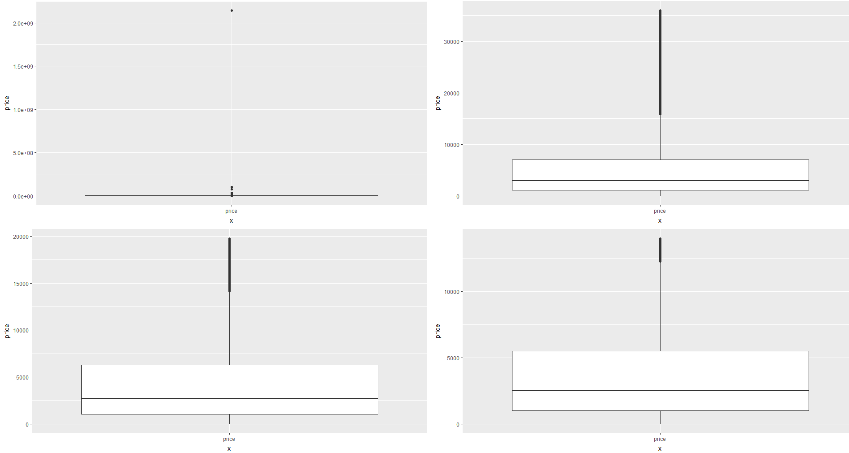
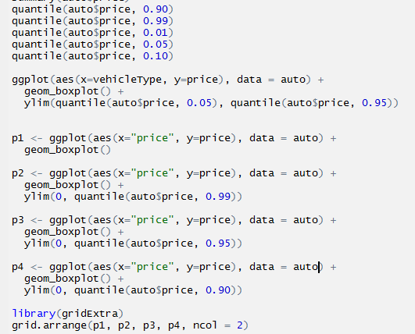
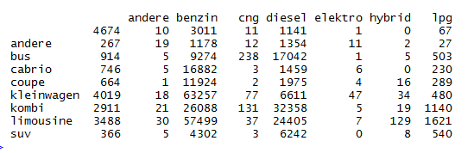
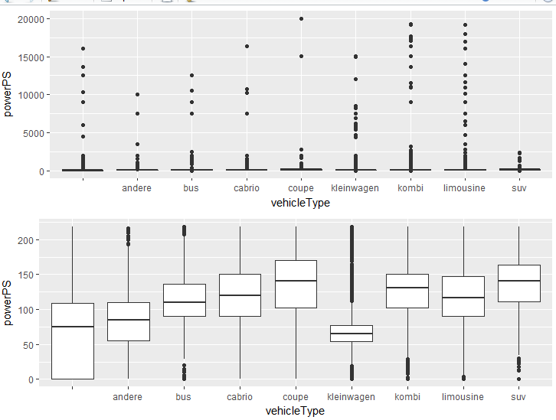

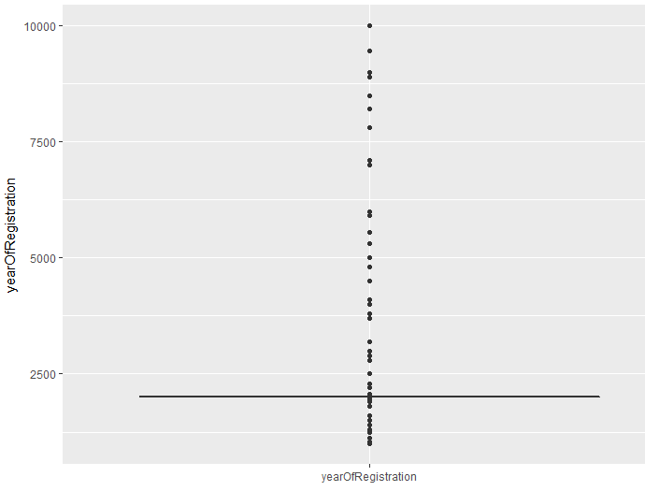
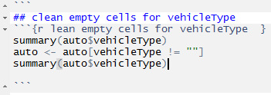
Content
Price
1
Raw Data Visualization
Check missing data and other mistakes
Create a list of outliers or other anomalies
Data Cleaning
2
3
4
5
PowerPS
6
7
8
Year of Reg.

Slide 7
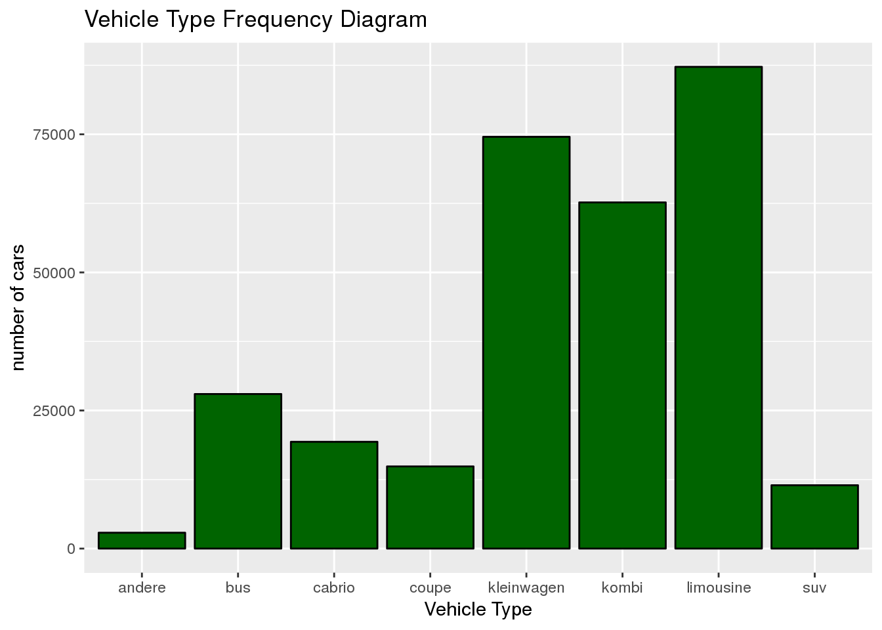

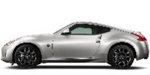
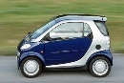
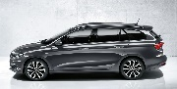
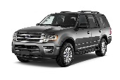
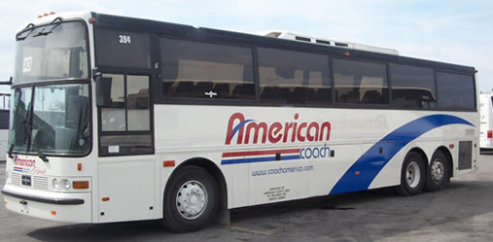
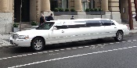

Content
1
2
3
4
Clean Data
Visualization
5
6
7
8

Slide 8
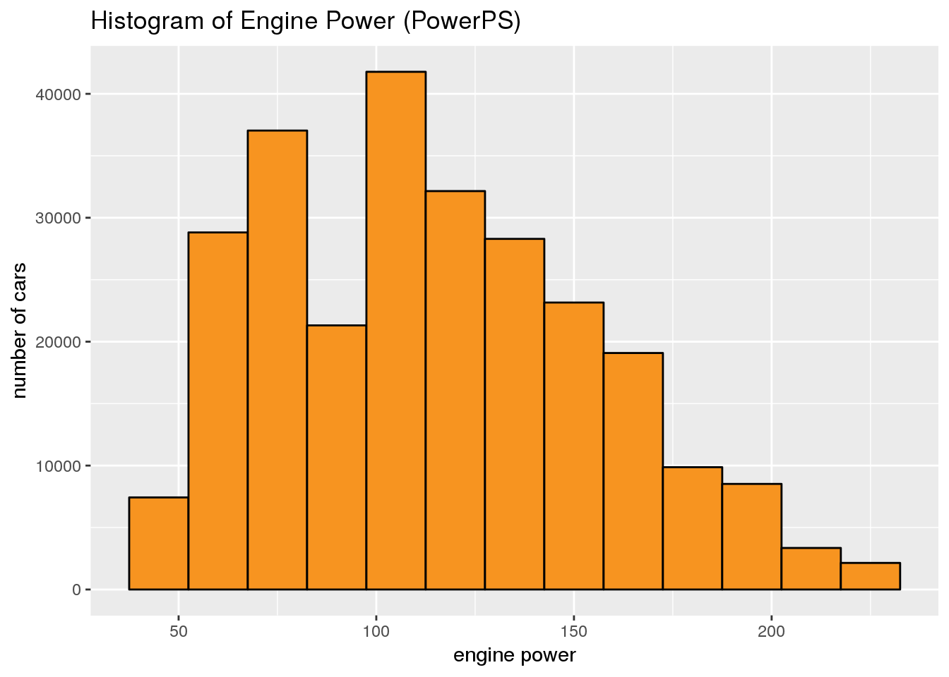
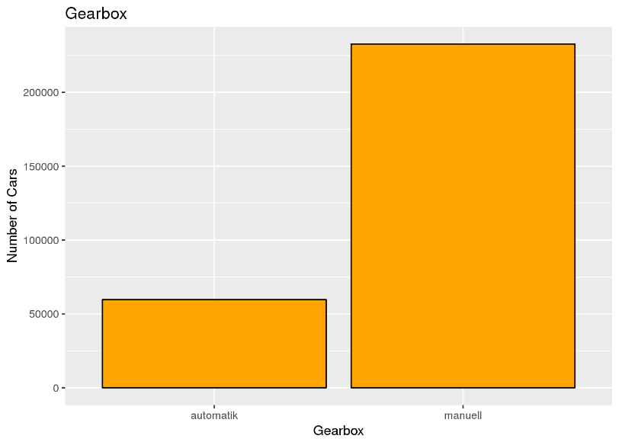
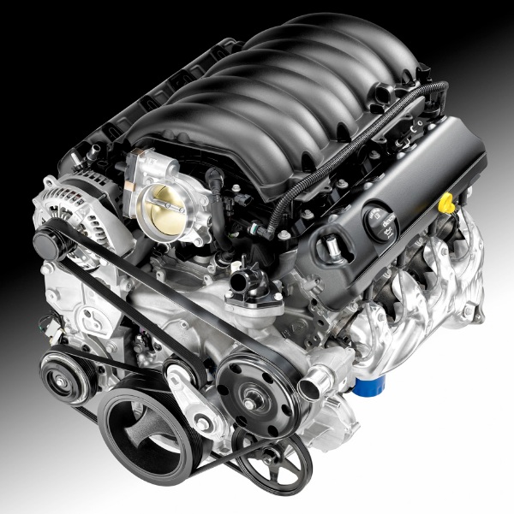
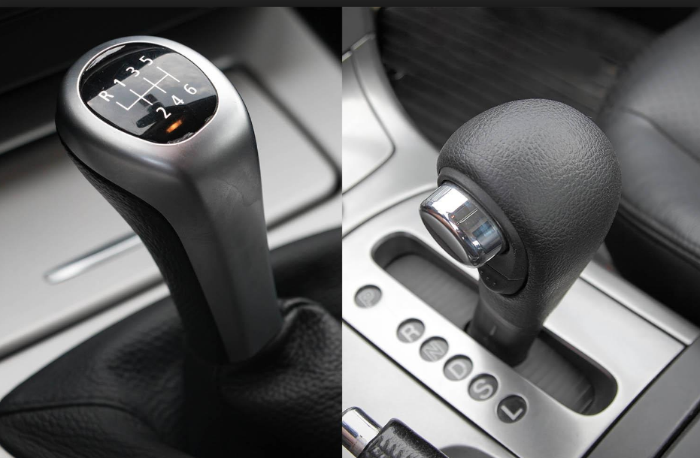
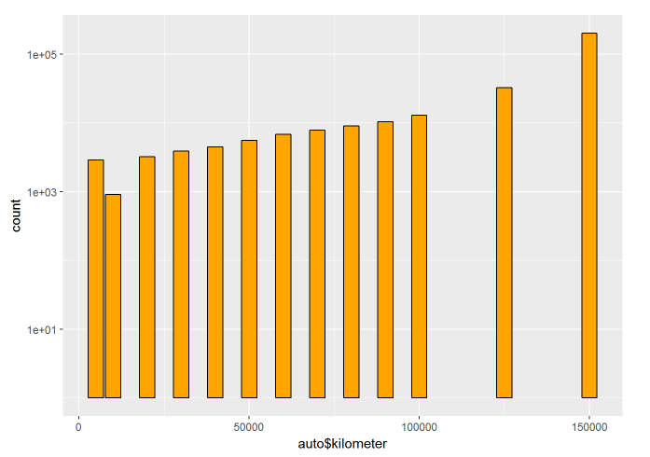
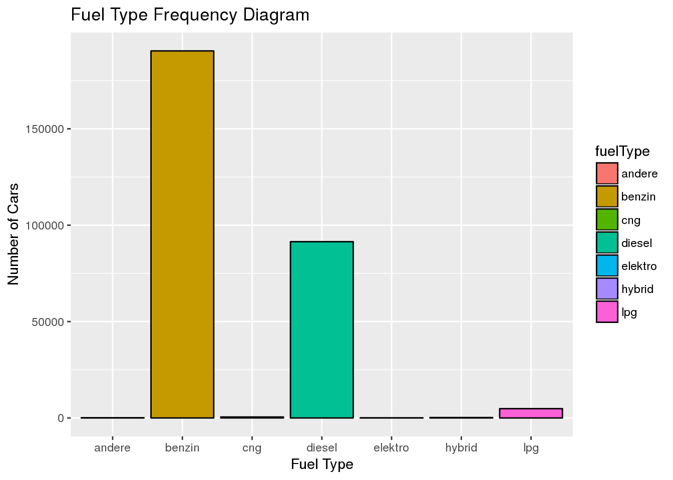
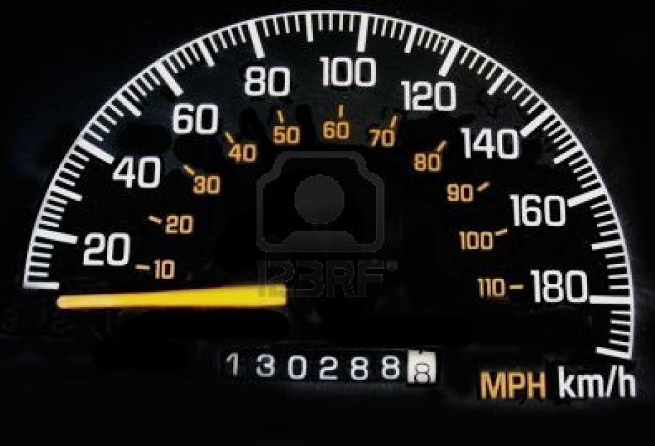
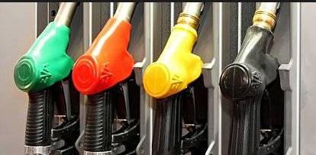
Content
1
2
3
4
Clean Data
Visualization
5
6
7
8

Slide 9
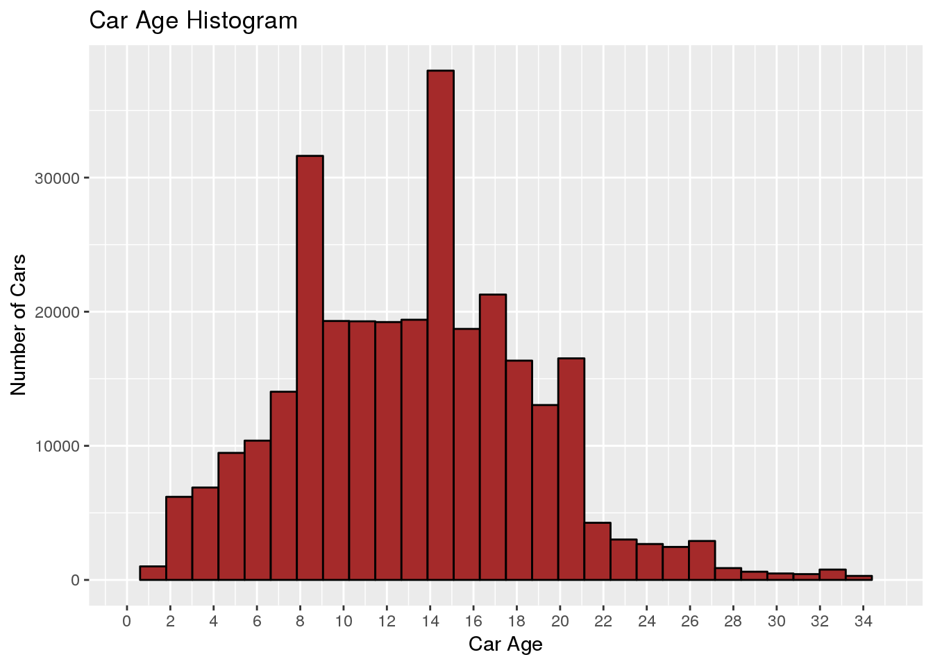
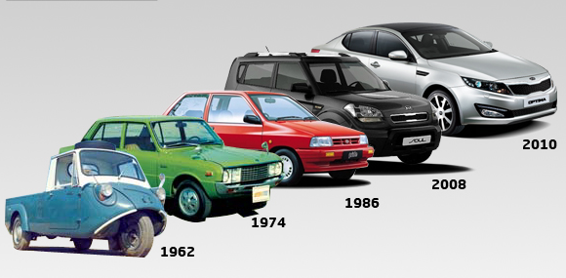
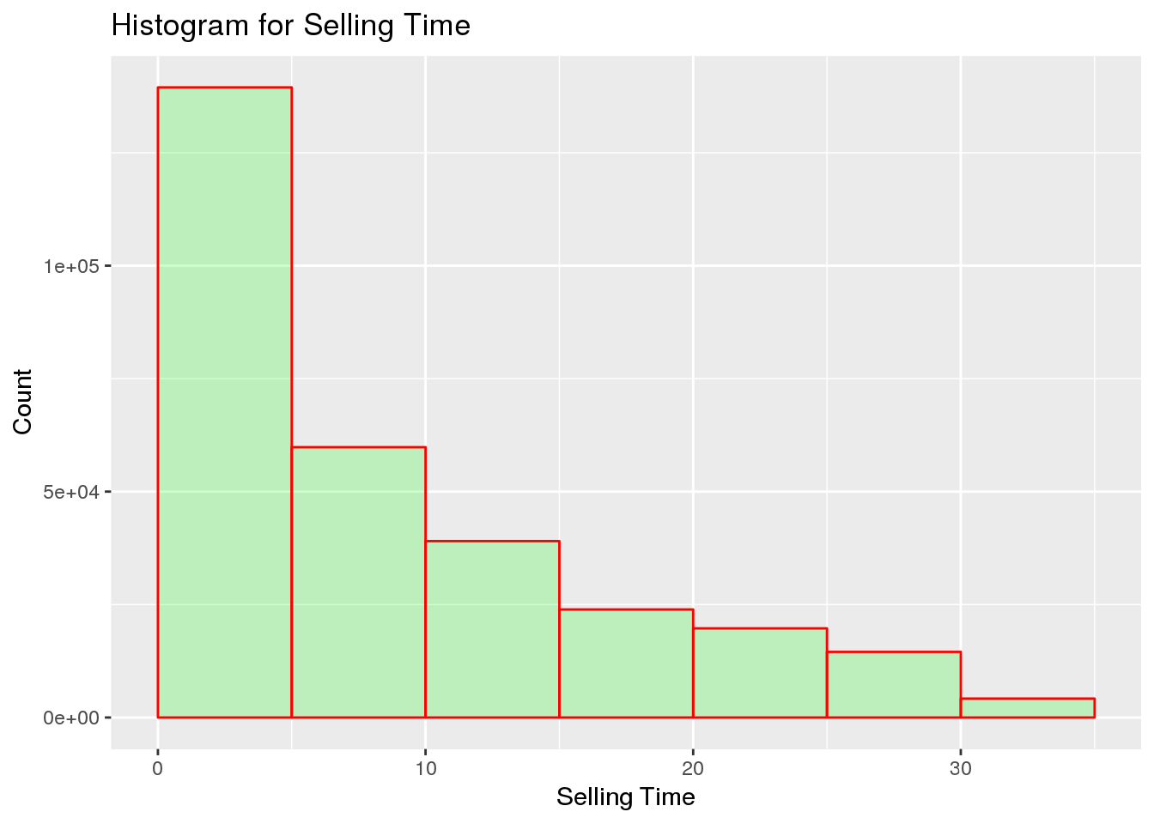

Content
1
2
3
4
Clean Data
Visualization
5
6
7
8

Slide 10
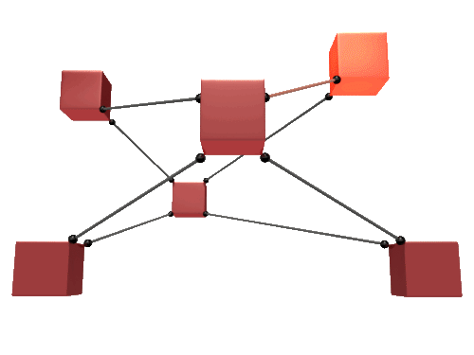
Content
Engine Power
Vehicle Type
Price
1
2
3
4
5
6 Determine relationships among the variables
7
Selling Time
Age
Fuel Type
8

Slide 11
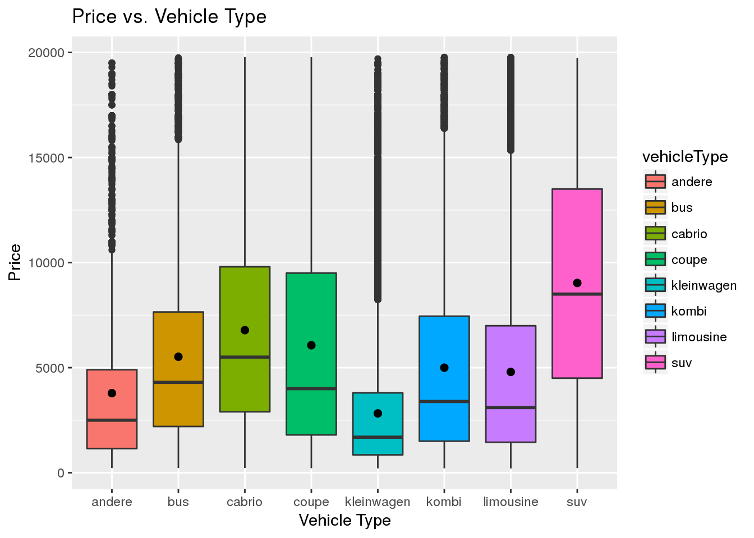
Content
1
2
3
4
5
6 Determine relationships among the variables
7
8

Slide 12
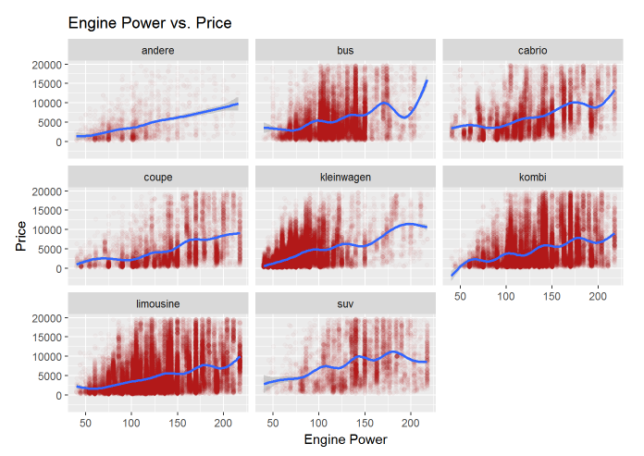
Content
1
2
3
4
5
6 Determine relationships among the variables
7
8

Slide 13
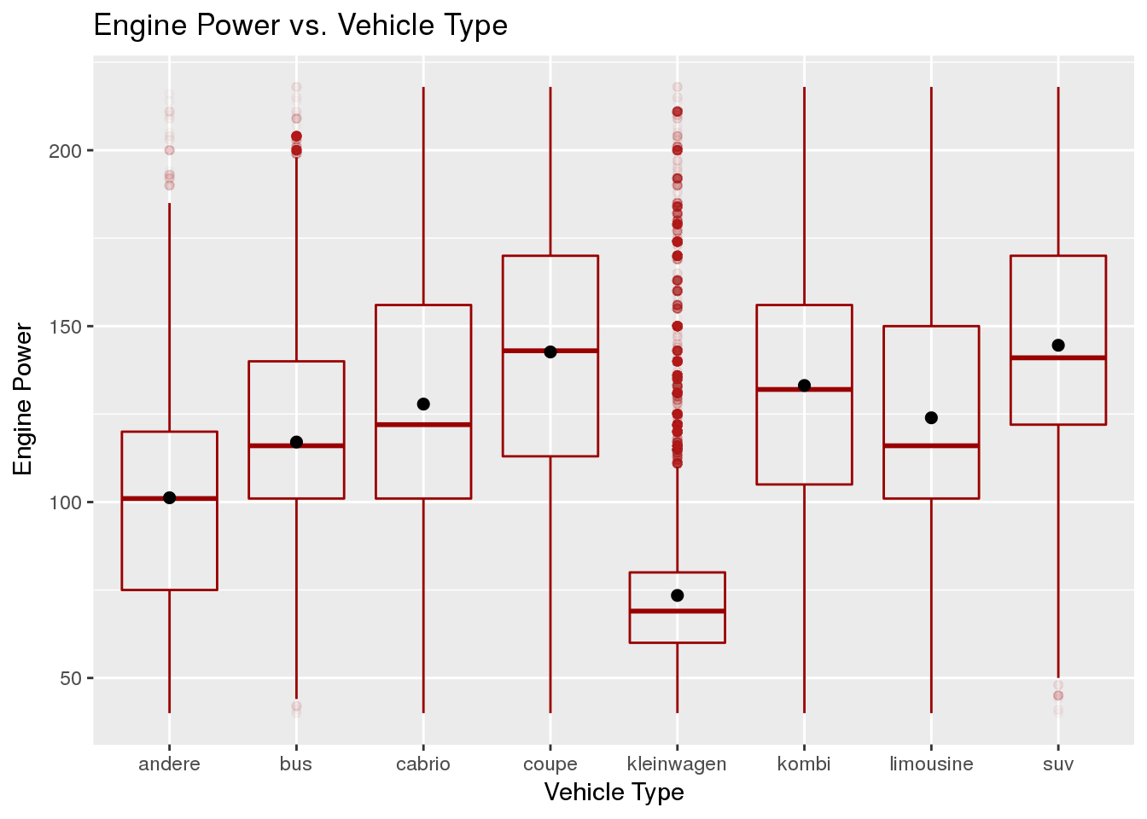
Content
1
2
3
4
5
6 Determine relationships among the variables
7
8

Slide 14

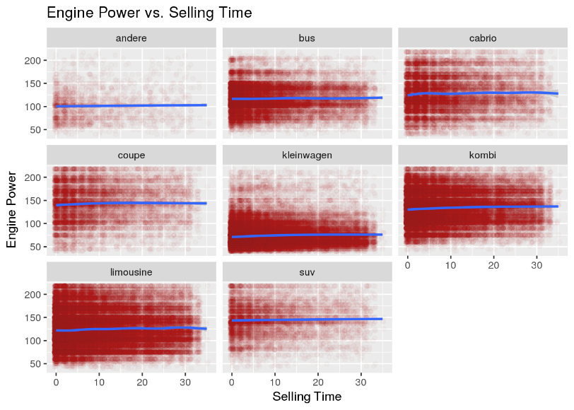
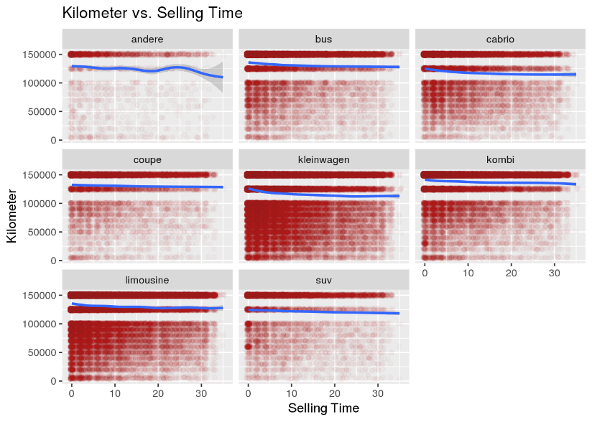
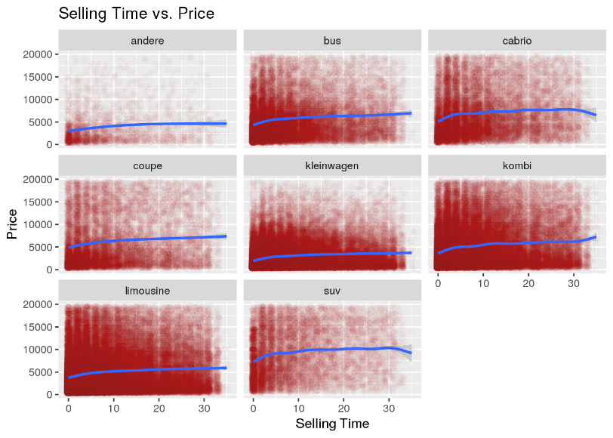
Content
1
2
3
4
5
6 Determine relationships among the variables
7
8

Slide 15
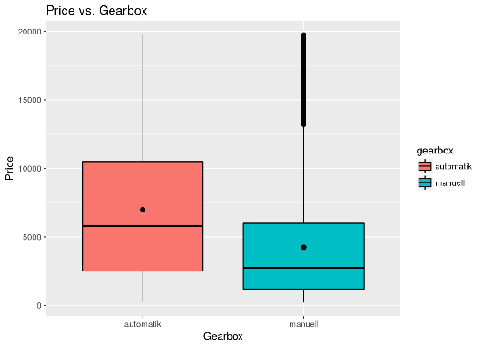
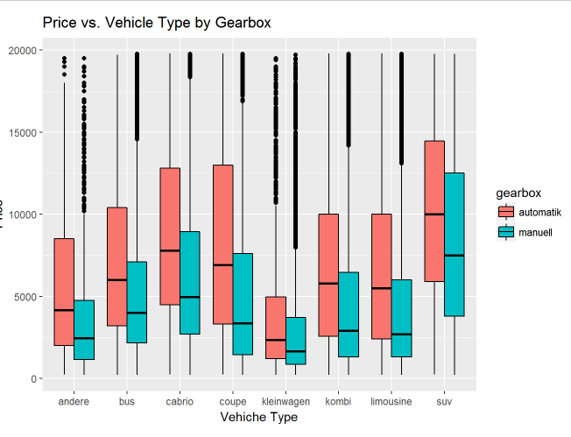
h
Content
1
2
3
4
Automatic gearbox cars are more expensive than the manual ones but the difference becomes less significant in cheap cars, i.e. Kleinwagen.
5
6 Determine relationships among the variables
7
8

Slide 16
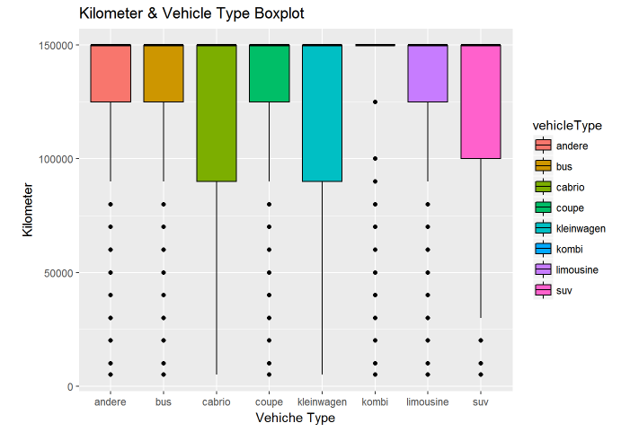
Content
1
2
3
4
5
6 Determine relationships among the variables
7
8

Slide 17
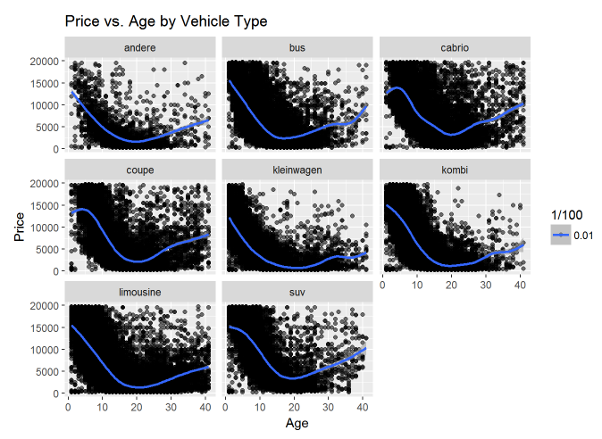
Content
In all vehicle types, the price continues to decrease between 0-20 years (20 years is the lowest point) but starts increase after between 20-30 years.
1
2
3
4
5
6 Determine relationships among the variables
7
8

Slide 18
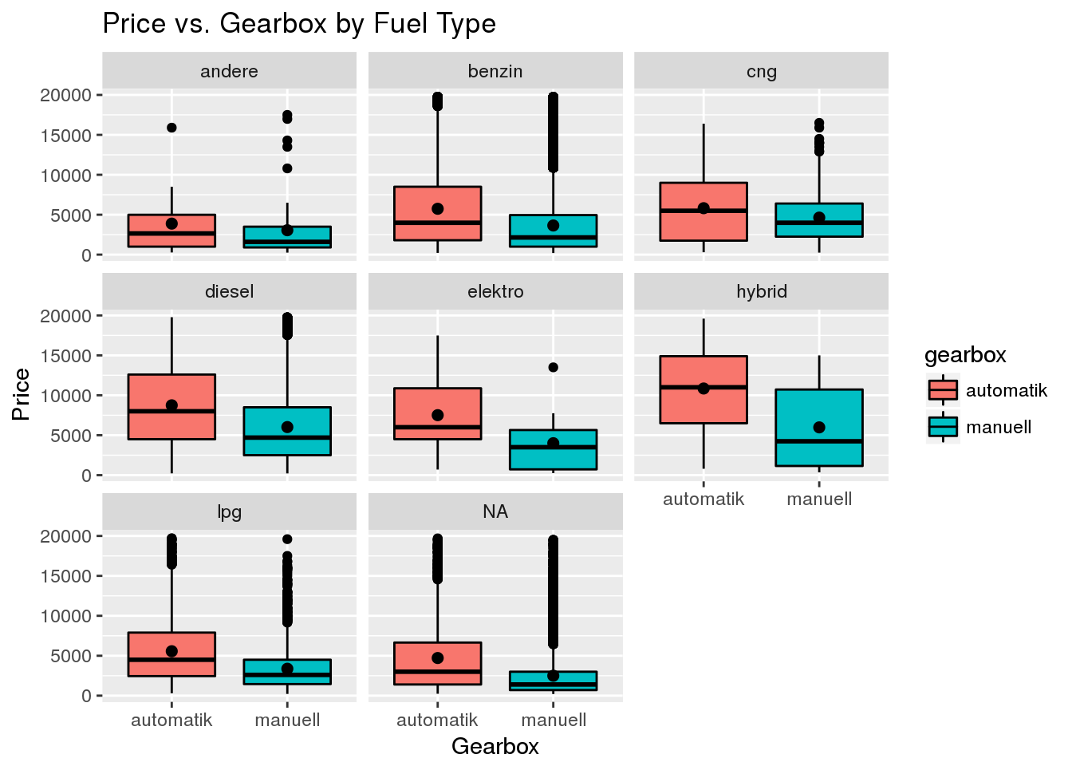
Content
In general, automatic gearbox cars are more expensive than the manual ones. This is especially significant in hybrid cars.
1
2
3
4
5
6 Determine relationships among the variables
7
8

Slide 19
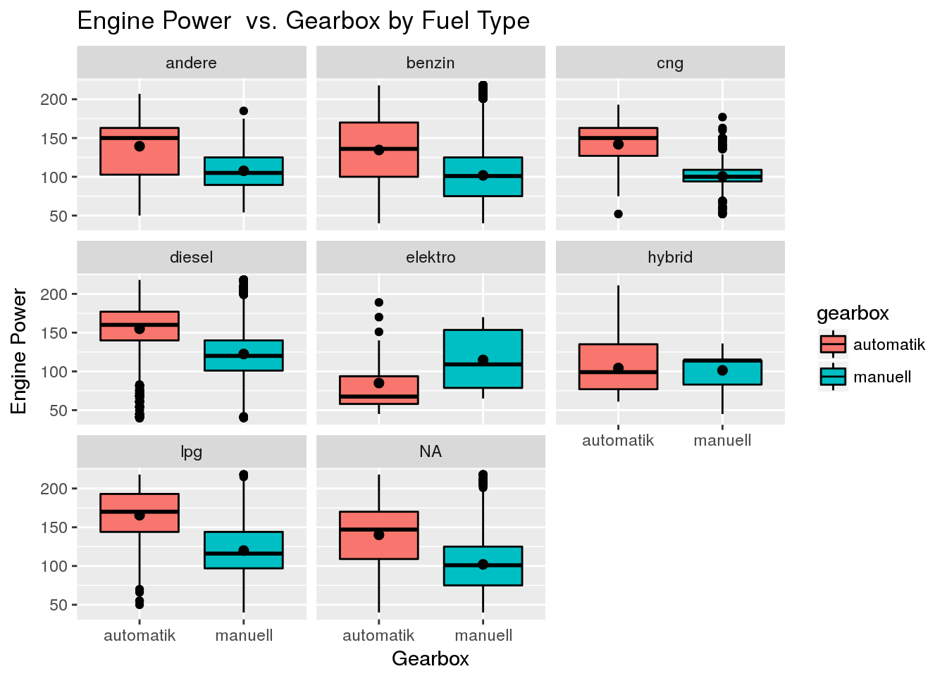
Content
Only electric cars with manual gearbox have superior engine power performance to the automatic ones. This divergence is one of the most interesting things we have found.
1
2
3
4
5
6 Determine relationships among the variables
7
8

Slide 20
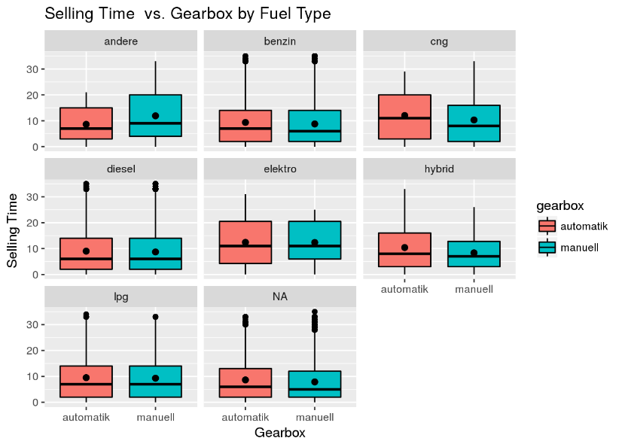
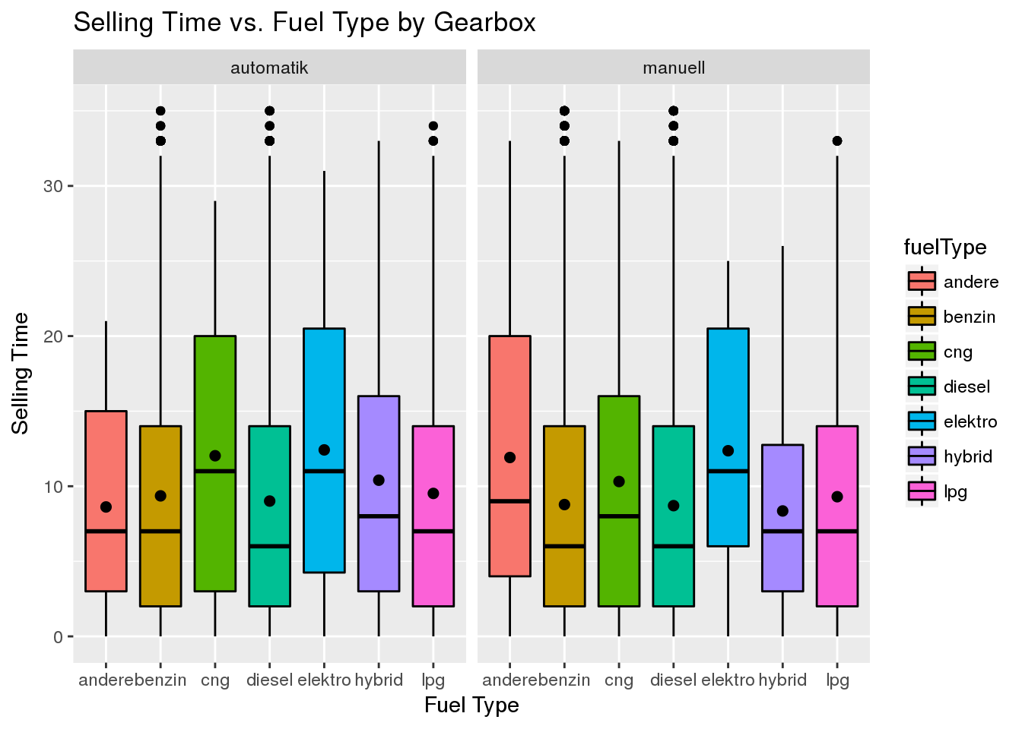
Content
Selling time does not seem to be affected by the combinations of gearbox and fuel type as well, with the exception of CNG cars.
1
2
3
4
5
6 Determine relationships among the variables
7
8
The electric and CNG cars show longer selling time trend which may indicate that second-hand car market for hybrid cars have not matured yet.

Slide 21
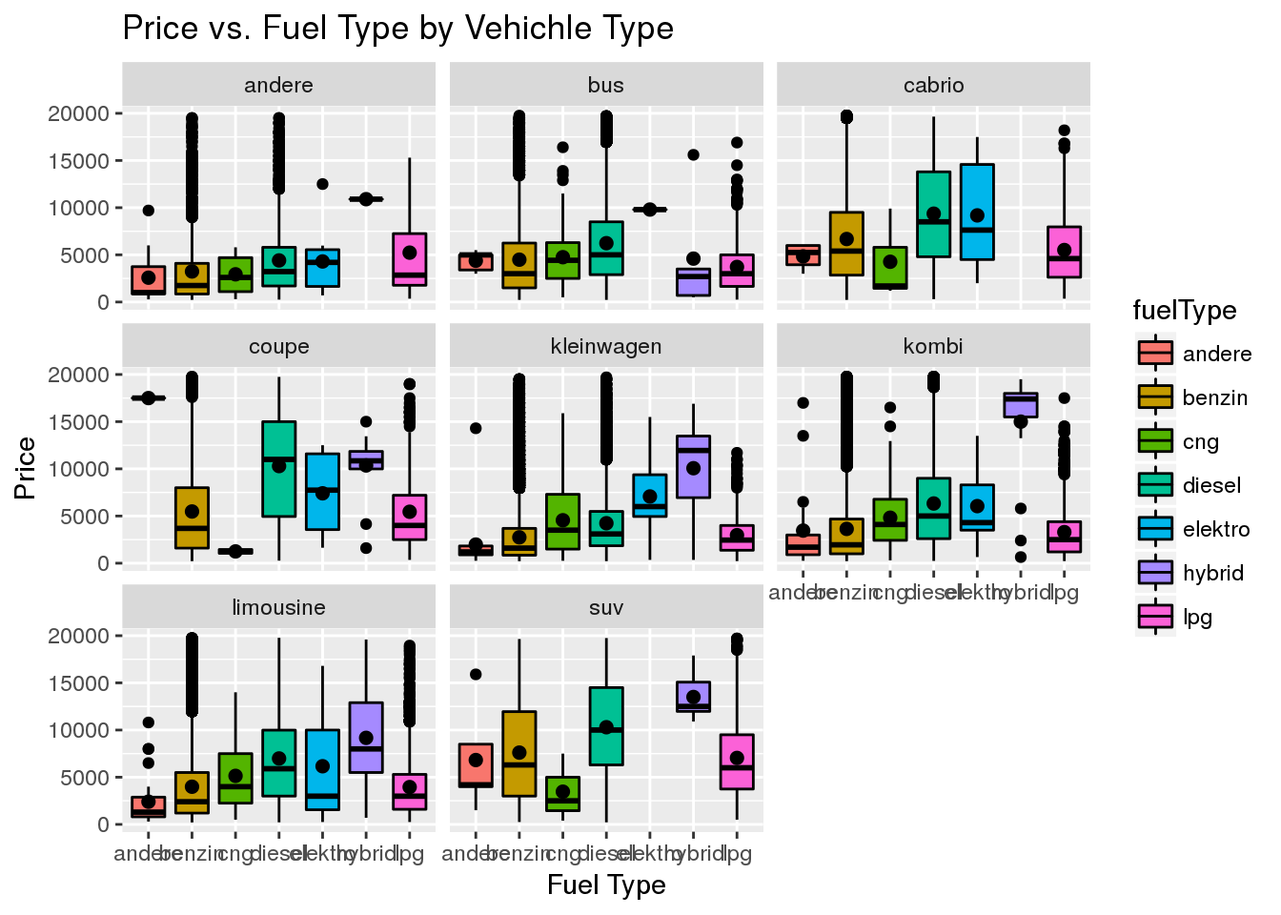
Content
In cheap cars (Kleinwagen), electric-hybrid fuel type makes a significant increase in price.
1
2
3
4
5
6 Determine relationships among the variables
7
8

Slide 22
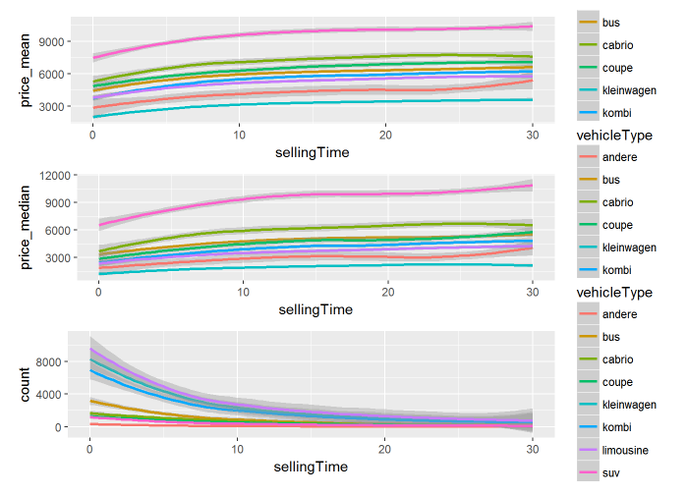
Content
Majority of the cars are sold only within 10 days in all vehicle types. For the first 20 days, whenever the price goes up, the selling time increases as well but this correlation stabilize in day 20. This trend is especially visible in SUV vehicles.
1
2
3
4
5
6 Determine relationships among the variables
7
8

Slide 23
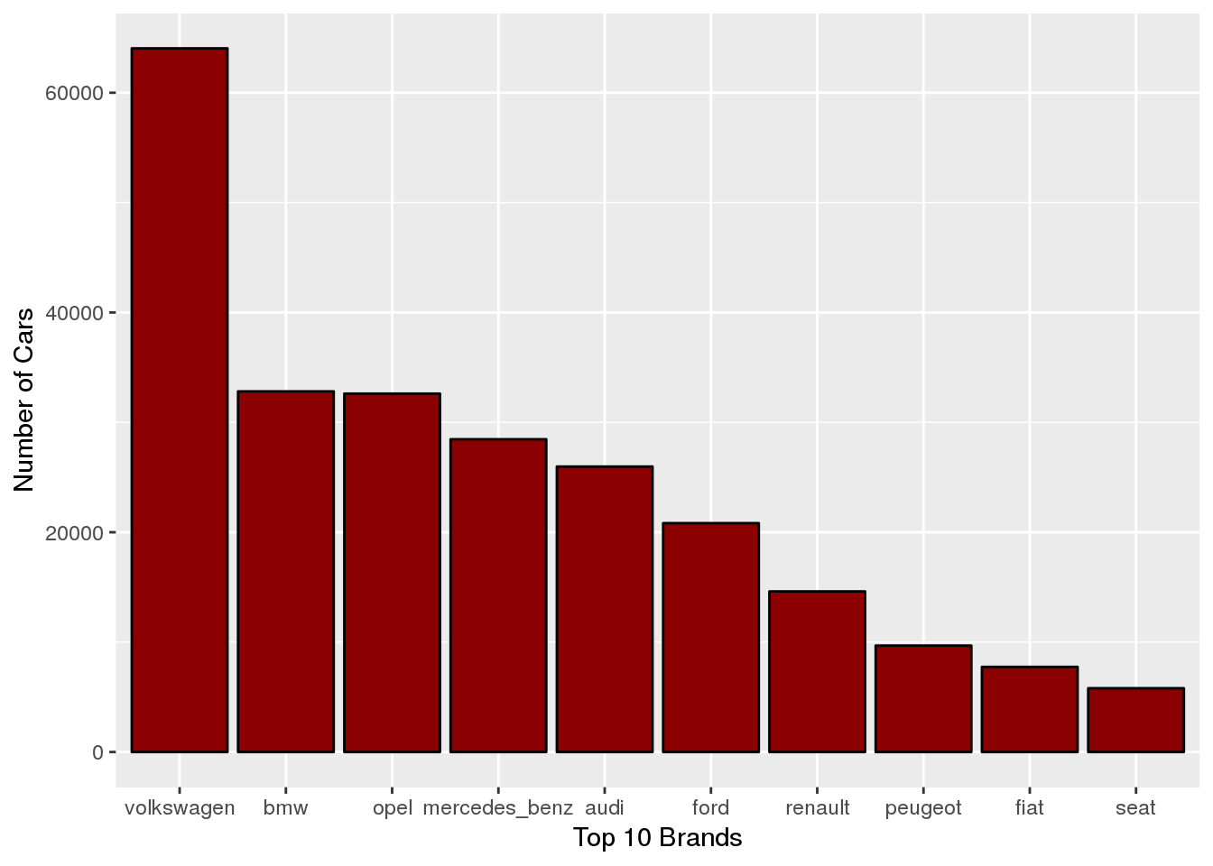
Content
Top 10 Brands (%80 second hand sales)– Most popular in the second-hand car market
1
2
3
4
5
6 Determine relationships among the variables
7
8

Slide 24
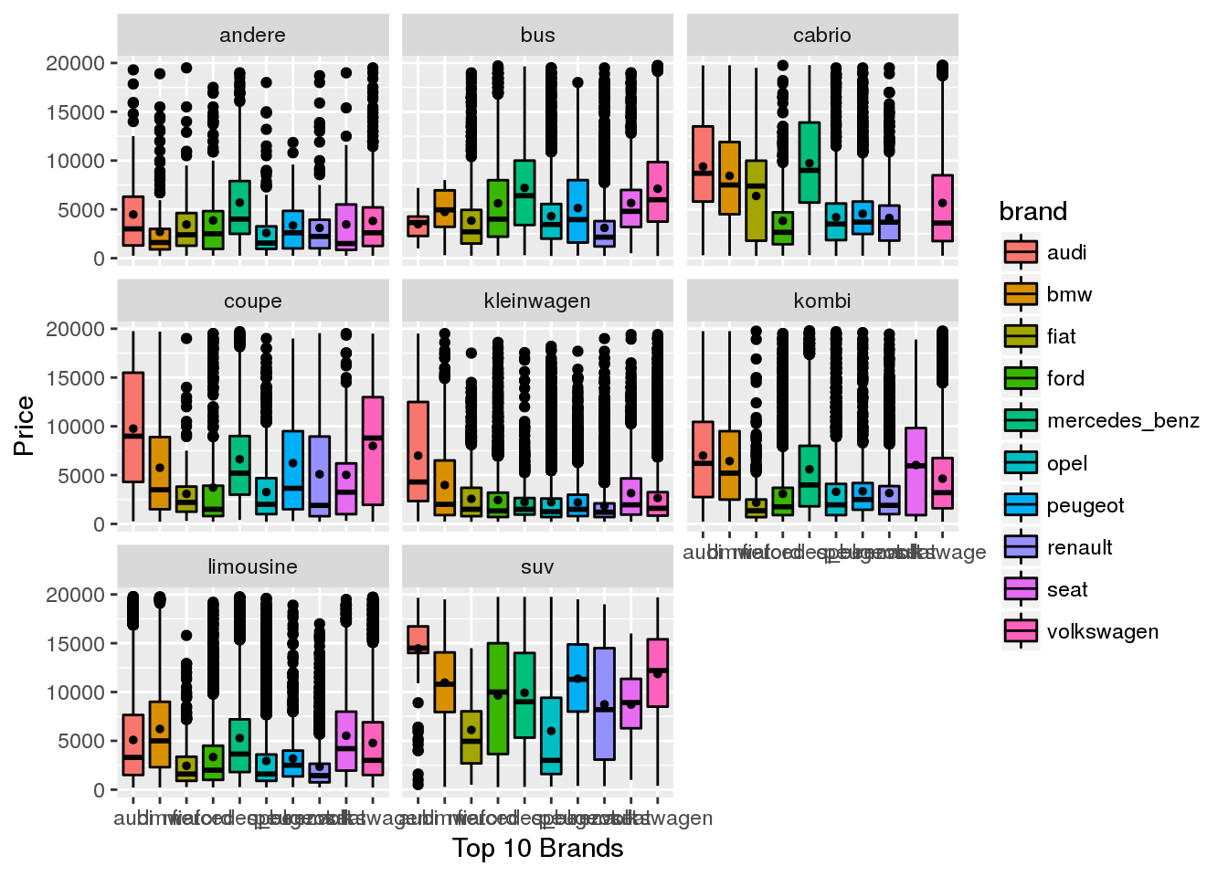
Content
Top 10 brands
1
2
3
4
5
6 Determine relationships among the variables
7
8

Slide 25
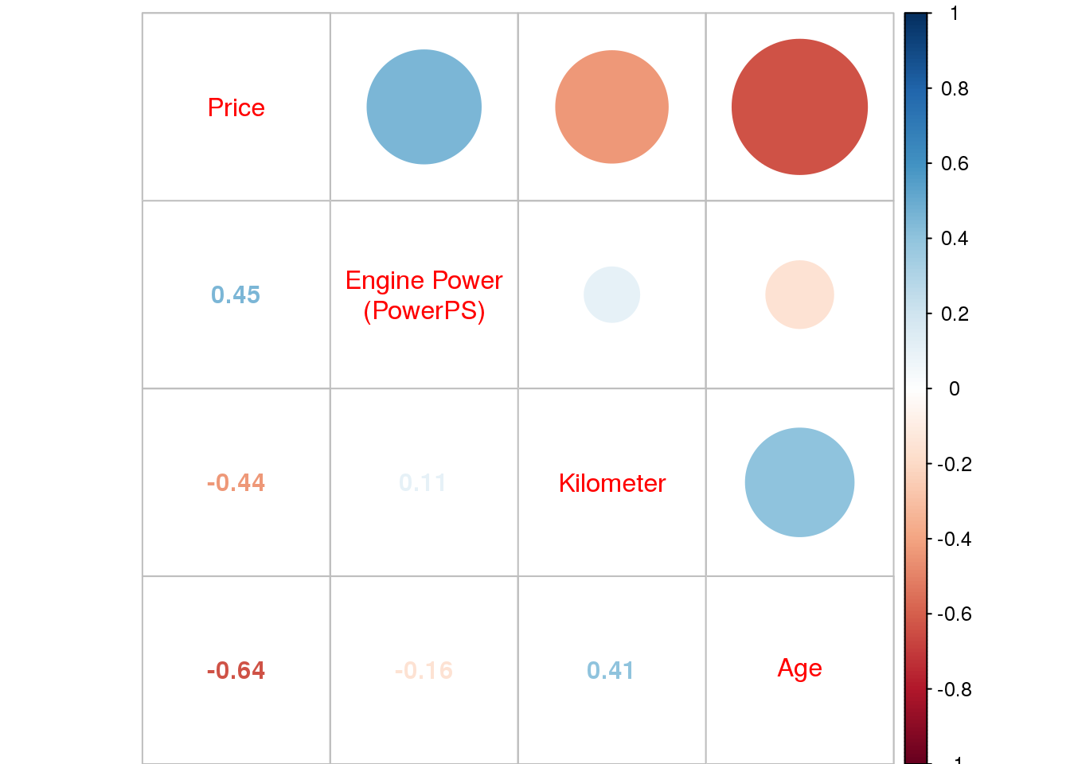

Content
Correlations
1
2
3
4
5
6 Determine relationships among the variables
7
8

Slide 26

Content
We split data into 2 parts before regression analysis
1
Training Data
%70
2
3
4
5
6
Regression Analysis
7
8
Validating Data
%30

Slide 27
Content
Regression Analysis Results for Training Data
1
2
kilometer
Fuel Type
3
4
5
R²=0.64
6
age
Vehicle Type
Price
Regression Analysis
7
8
PowerPS
Gear Box

Slide 28
Content
Q: What factors are most important for Price?
Least Important
Most Important
-
Age
%39
1
-
Kilometer
%23
2
+
Engine Power
%19
3
Age, Kilometer and Engine Power are the most important factors that explains second hand car price
4
Diesel
%5
5
Kleinwagen
%3
6
Regression Analysis
Benzin
%3
7
Suv
%2
8
Cabrio
%2
Automatik
%1
Manuel
%1
Kombi
%1
Bus, coupe, limousine and lpg
%0

Slide 29
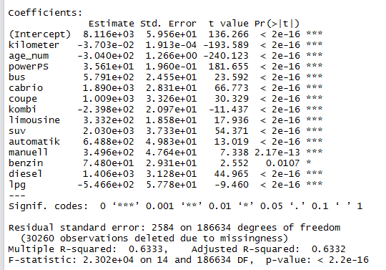
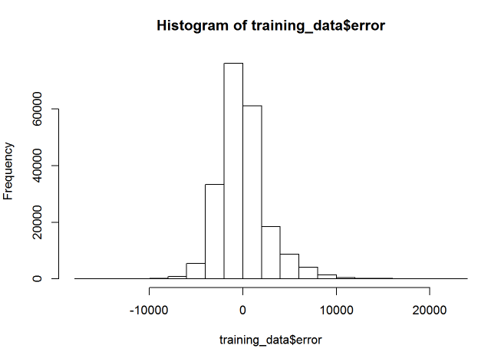
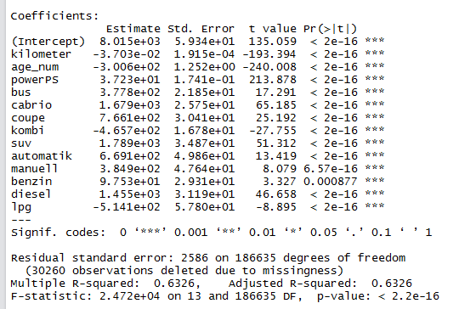
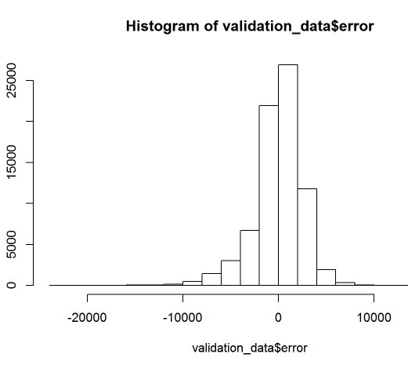
Content
Model Diagnostics
R²
1
Training Data
%63
2
3
4
5
6
Regression Analysis
7
8
Validating Data
%63

Slide 30
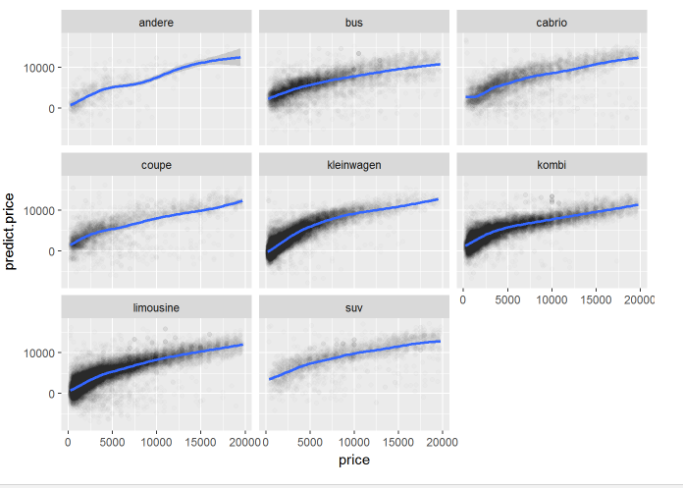
Content
Actual vs Predicted Price
1
2
3
4
5
6
Regression Analysis
7
8

Slide 31

Content
1
2
3
4
5
6
7
Maps
8

Slide 32




Content
1
2
3
4
5
6
7
Maps
8

Slide 33
Content
Limousine, kombi and kleinwagen are the most popular vehicle types in the second-hand market. Most expensive cars are SUV’s while the cheapest ones are kleinwagens.
On average Kleinwagen vehicle type is the cheapest and has the lowest engine power. But it also shows the most outliers – might be as a result of brand-model diversity.
The most popular brands are Volkswagen, BMW, Opel, Mercedes, Audi, Ford, Renault, Peugeot, Fiat and Seat. These 10 brand correspond to almost 80% of the cars. (Originally our dataset contains around 40 brands)
Most of the cars in the second-hand market are above 100.000 km, even 150.000 km. People does not frequently change cars according to our data set.
Majority of the second-hand cars are sold only within 35 days. The ratio of the first 10 days (day 0 stands for same day sale) is quite high. This shows us that either Ebay-Kleinanzeigen is very successful at targeting customers or the second-hand market is more fluid that we actually thought.
1
2
3
4
5
6
7
8
Conclusion
9

Slide 34
Content
To our surprise, there is no strong/significant correlation between selling time and vehicle type, kilometer and price. We saw that whenever price goes up the change to be sold in 10-20 days increases especially in SUV vehicles (rather than 0-10 days) but this is not a general trend.
Hybrid (electro engine, CNG) second-hand car market is emerging but shows longer selling time trend.
In all vehicle types, the price continues to decrease between 0-20 years (20 years is the lowest point) but starts increase after between 20-30 years. Maybe, 20+ year old second-hand cars can be considered as ‘antique’ and users’ emotional attachment may cause abnormalities.
Hybrid cars with manual gearbox have superior engine power performance. This is a divergence from all correlations and one of the most interesting things we have found.
According to our regression analysis, age (39%), kilometer(%23) and engine power(%19) are the most important factors explaining second hand price.
Zip code analysis shows that kombi is the most popular second hand car when the zip code is provided.
East Coast second hand car market is bigger.
1
2
3
4
5
6
7
8
Conclusion
9

